Slide 1

FEATURE ENGINEERING
&
MODEL BUILDING
Project : Churn Customer Prediction Domain : Telecom
Objective:
The high annual churn rate of over 10% is a significant issue for telecommunications companies. To minimize customer loss, they implement strategies to retain as many clients as possible.
Contributors :
Monika Choudhary Kuldeep Jeengar
Hiba Kabeer Shiva Prasad P
Arya Pathak
Mentors :
Karthik & Dhanya Priya

Slide 2
Context :
Data Reading, Analysis, Cleaning & Datatype Conversions
Correlation and Relationship between Features
Feature Selection
Data Labeling
Outlier Detection
Data Scaling
Features Importance

Slide 3

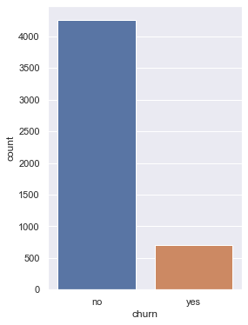
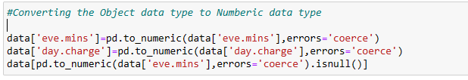
Data Reading, Analysis, Cleaning & Datatype Conversions
Reading the dataset with help of Pandas library.
In Data analysis we found that there are two columns(Evening Minutes & Day Charge) which are mention as Object data type even though they supposed to be the numeric data types.
Data type conversion from object to numeric using the pandas utilities.
Post Datatype conversion, there are 31 null records which are un-supported to the column data type, removing them for further process.
The Count plot shows the data portions of the Churn and Loyal customer in given dataset.

Slide 4
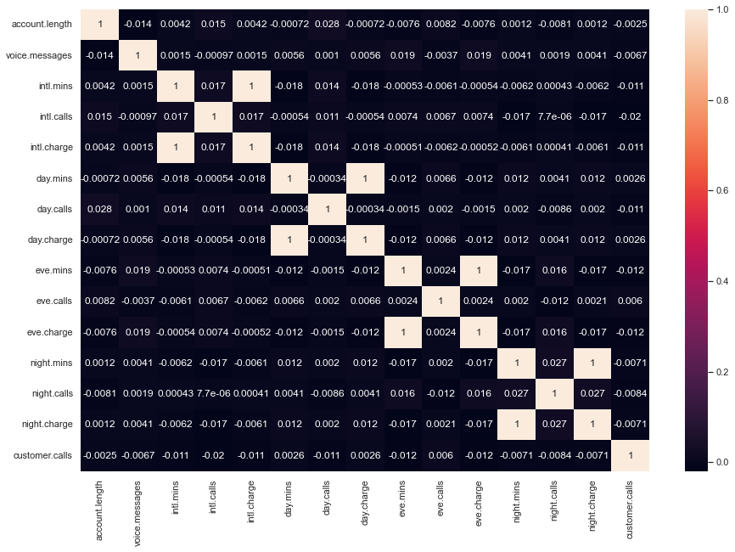
Correlation and Relationship between Features
In the given dataset we have total 8 features dependent on the at least one of the other feature. Below are the Correlation Stats,
Evening Mins ~ Evening Charge
Intl Mins ~ Intl Charge
Day Mins ~ Day Charge
Night Mins ~ Night Charge
Multi-collinearity:
High correlation between features can cause multi-collinearity, which can make it difficult to interpret the importance of individual features and the coefficients in a statistical model.
Feature Selection:
High correlation between features can make it challenging to perform feature selection, as it may not be clear which feature to keep and which to remove.
Redundancy:
Correlated features can be seen as redundant information, providing similar information to the model. This can lead to inefficiencies in the training process and decreased accuracy.

Slide 5
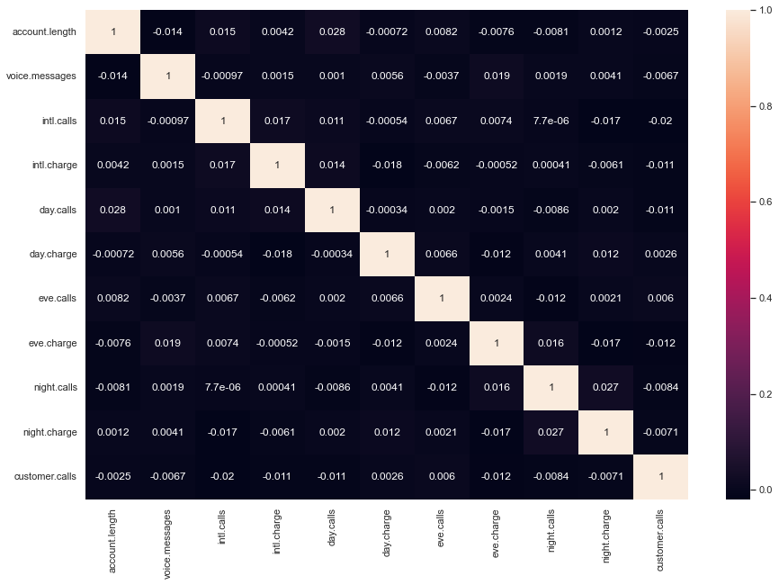

Feature Selection
Reducing multi-collinearity:
Correlated features can lead to multi-collinearity in the dataset, which can affect the interpretability and stability of the model's coefficients.
Improving model performance:
Correlated features can also slow down the training process and decrease the accuracy of the model. Removing correlated columns can lead to a more robust and efficient model.
Feature selection:
Correlated features can be seen as redundant information, as they provide similar information to the model. By removing them, you are essentially performing feature selection, which can simplify the model and lead to better interpretability.
The Features removed to protect from correlation:
State
Area Code
International Mins
Day Mins
Evening Mins
Night Mins

Slide 6

Data Labeling
Label encoding is an important step in the preprocessing phase of model building because it converts categorical variables into numerical values, which are easier for a machine learning algorithm to understand and process.
Most machine learning algorithms require numerical inputs and cannot work with categorical variables directly.
Label encoding helps to eliminate ordinal relationships between categories, which can impact the accuracy of the model if not handled properly.
Label encoding can reduce the dimensionality of the dataset and improve the efficiency of the model.
International Plan (Yes/No)
Voice Plan (Yes/No)
0 1 0 0 0 1 0 1 1
Churn (Yes/No)

Slide 7
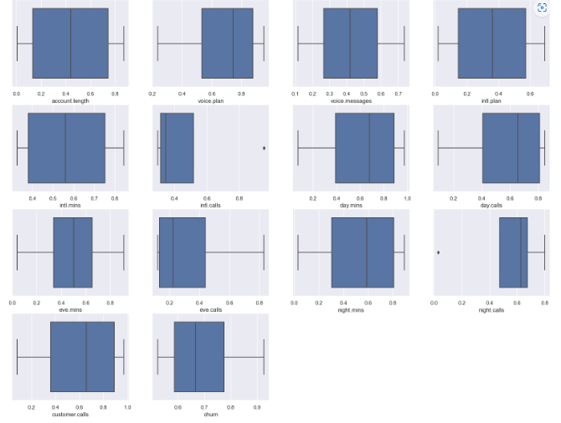
Outlier Detection
Outliers are data points that are significantly different from the majority of the data. In a box plot, outliers are visualized as individual points outside of the box. Outliers can have a significant impact on the results of a statistical analysis and can lead to incorrect conclusions. Therefore, it's important to identify and handle outliers appropriately.
By visualizing the data using a box plot, you can easily identify the presence of outliers in the data. This information can be useful in guiding further analysis, such as investigating the cause of the outliers or deciding whether to remove them from the dataset. Since, we have a large number of outliers in our dataset, removing all of them may not be a practical solution as it may result in a significant loss of information.

Slide 8
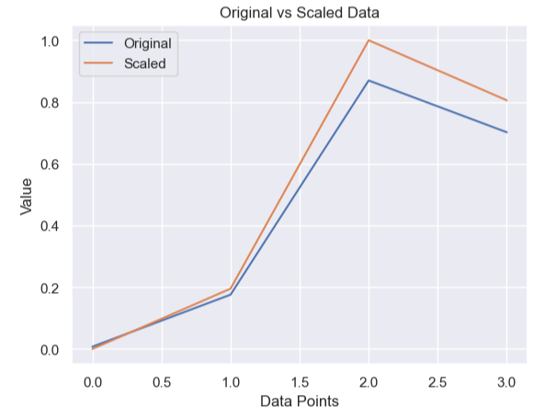
Data Scaling
Data scaling :
It ensures that the values of different features are on the same scale, which helps to prevent bias in algorithms. The most commonly used method for data scaling is Min-Max scaling.
This plot can help you see how the different values of the data have been transformed to the same scale, making it easier to analyze and compare the values.

Slide 9
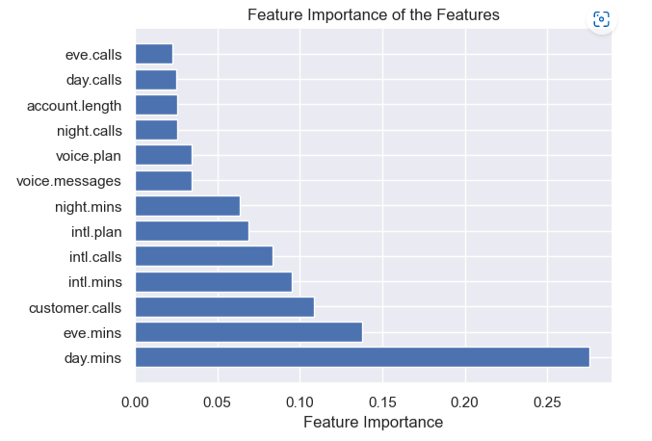
Features Importance
Feature importance :
It refers to the relevance or importance of each feature in a dataset in predicting the target variable. Different methods exist for measuring feature importance, and the results can be used to make informed decisions about feature selection. This can improve the performance of the model, reduce overfitting, and lead to more accurate predictions.
The resulting plot shows the relative importance of each feature in the dataset.
Here, day.mins, eve.mins and customer calls have more importance in respective to others.

Slide 10

Model Building
By generalising and learning from training data, machine learning algorithms are built by a mathematical representation to predict most accurate outcome from the given inputs.
Here we are using:
Naive Bayes
Support Vector machine.
Random Forest.
Logistic Regression
Neural Network.

Slide 11

NAIVE BAYES :
Naive Bayes classifiers are often considered to be one of the best models for certain classification tasks due to several reasons:
Good Performance with Small Datasets
Independence Assumption
Robustness to Irrelevant Features
Data | Raw Data |  | Scaled Data |  | Smote & Scaled
Metric | Accuracy | F1 Score | Accuracy | F1 Score | Accuracy | F1 Score
Model | 87% | 92% | 87% | 92% | 88.4% | 93.8%

Slide 12
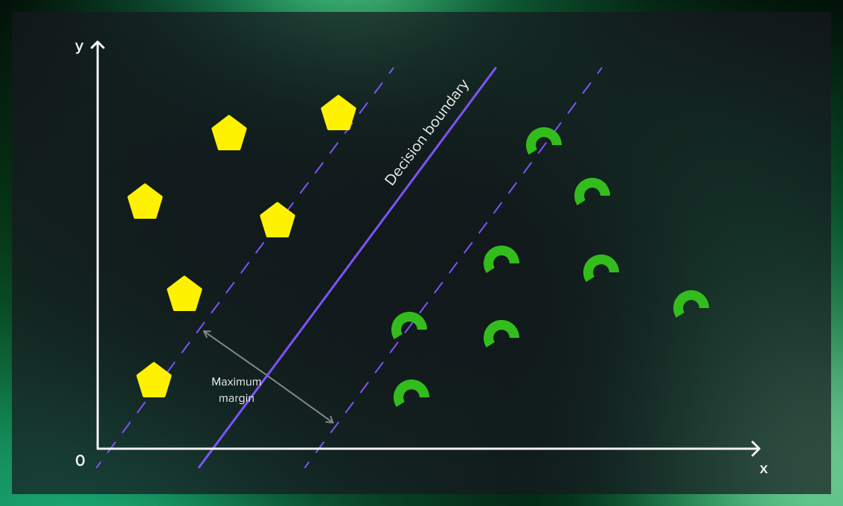
SUPPORT VECTOR MACHINE : The idea of SVM is simple: The algorithm creates a line or a hyper plane which separates the data into classes .
Ability to Learn Non-Linear Boundaries
Robustness to Outliers:
Kernel Trick:
Data | Raw Data |  | Scaled Data |  | Smote & Scaled
Metric | Accuracy | F1 Score | Accuracy | F1 Score | Accuracy | F1 Score
Model | 87% | 93% | 87% | 97% | 94% | 97%

Slide 13

RANDOM FOREST : A Random Forest Algorithm is a supervised machine learning algorithm which is extremely popular and is used for Classification and Regression problems in Machine Learning .
Handling Missing Values
Handling Categorical Variables
Feature Importance
Data | Raw Data |  | Scaled Data |  | Smote & Scaled
Metric | Accuracy | F1 Score | Accuracy | F1 Score | Accuracy | F1 Score
Model | 89% | 94% | 89% | 94% | 93% | 96%

Slide 14

Logistic Regression : A logistic regression model predicts a dependent data varible by analyzing the relationship between one or more existing independent variables. .
Simple and Interpretable
Fast Training
Probabilistic Output
Data | Raw Data |  | Scaled Data |  | Smote & Scaled
Metric | Accuracy | F1 Score | Accuracy | F1 Score | Accuracy | F1 Score
Model | 86% | 93% | 86% | 93% | 86% | 92%

Slide 15

NEURAL NETWORKS : Neural network classifiers are considered to be some of the best models for classification tasks due to several reasons:
Representation Learning
Robustness to Noise
Generalization Ability
Data | Raw Data |  | Scaled Data |  | Smote |  | Smote & Scaled
Metric | Accuracy | Loss | Accuracy | Loss | Accuracy | Loss | Accuracy | Loss
Model | 85.7% | 0.45 | 92.5% | 0.2 | 85.4% | 0.6 | 87% | 0.4

Slide 16
Summary
Algorithm / Metrics | Accuracy | F1Score | Loss
Naïve Bayes | 89 % | 94 % | NA
Support Vector Machine | 94 % | 97 % | NA
Random Forest | 93 % | 96 % | NA
Logistic Regression | 86 % | 93 % | NA
Neural Network | 92.2 % | NA | 0.2
From the above metrics all the algorithm are giving good results but out of them SVM
and Random Forest are give the best results with F1 Score of 97 and 96 %.

